Slide 1
idLink Cloud ID Authentication Platform
Opens Doors
without Any Physical Door Controllers -
Seamless User Experience in Door Access

Slide 2
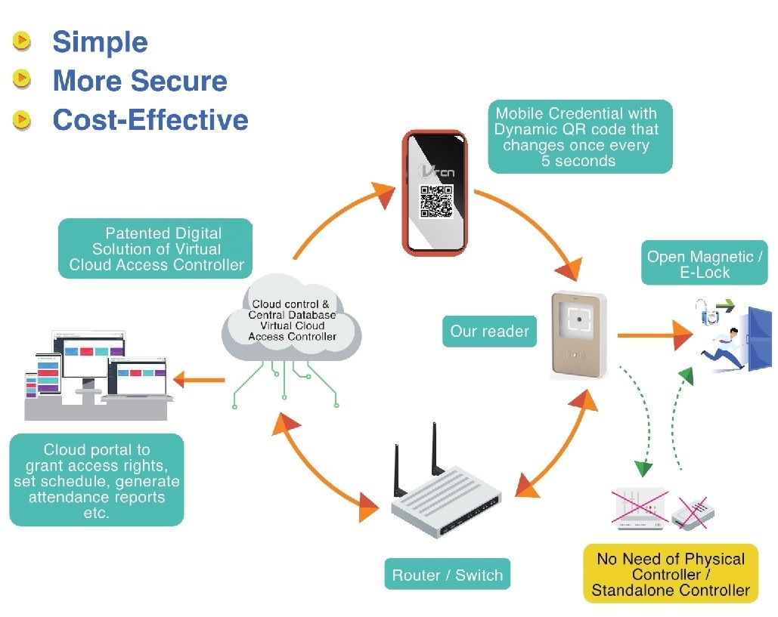
Move from Old Practice & Create New Simple ACS
4 core components in Old Practice
A Credential in Physical Cards, Virtual Card in BlueTooth, Fixed QR Code or Biometrics, being represented by a Unique Card ID Number (UID);
A reader that decodes the credential (RFID, Facial, QR Code, etc.)
A door controller unit
An access control software installed locally in a PC
vs
3 in idLInk New Cloud Access Control System (ACS)
Non-UID Mobile Credential in Dynamic QR Code changing once every 5 seconds to combat ID copying;
A special reader with dry relay output
A cloud platform acting as a virtual controller to authenticate registered users for door access

Slide 3
VRCN Vision
Seamless UX Into the Digital Connected World
Virtual Card Issuance to Mobile (Dynamic QR Code in Mobile App / Browser Based)
https://youtu.be/594tQwhrFHM
2. Cloud Identity Authentication (of Non-UID Based Mobile Credential)
https://youtu.be/se7DO5Y5XPA
3. Integrate with 3rd Party Community App
/ e-Platform for a More Comprehensive
One-stop Digital Solution https://youtu.be/ee28_vcaTIA
4. Automatic Access Accreditation of
Users and Engage Them into Further
IoT / Smart City Applications

Slide 4
VRCN Patented ACS Solution
A web platform, named idLink, with virtual controller on cloud where paid users would get their own cloud administration portals to manage access control functions such as issuance of personalized virtual cards, configuration of readers, assign users door access rights, generating reports, etc. Video demos are available at https://www.vrcnltd.com/cloud-access-control
SAVE COST
NO need to use EXPENSIVE physical door access controllers
SAVE TROUBLE
SAVE CUSTOMERS
A better door access experience, a SEAMLESS process of e-Pass / ticket booking online, payment, downloading of secure ticket on mobile, self accreditation at turnstiles
SAVE BUSINESS
Able to render API SUPPORT & integrate with 3rd party smart systems for more servicing, e.g. facilities booking, e-ticketing and digital membership, etc.
NO need to CONFIGURATE readers on-site but remotely via cloud log-in
Manage access control functions ANYTIME and ANYWHERE
Virtual Card in Dynamic QR Code changing every 5 sec. prevent copying

Slide 5
How VRCN Overcome Pain Points in Conventional Access Control System (ACS)
 | Issues in Old ACS | New Cloud ACS of VRCN
1 | Unique ID Card number (UID) as the credential, easy to compromise | Secure credential in the Virtual Card on mobile is non-UID based & self defined binding objects of the user profile Virtual card as Dynamic QR Code changing once every 5 sec. to prevent copying
2 | Many different proprietary data formats: Wiegand, Sony Felica, Desfire, Mifare+, etc., and hard to integrate with other sys. | Standard http / https protocol & common cloud language
3 | A physical door controller is a MUST in the system to store transaction data and access right distribution; expensive, Complicated and costly system architecture | Physical door controller is not needed Simple system architecture and much cheaper than old ACS
4 | Must need a specific software to work with the proprietary system and work on PC only | Cloud Virtual Controller with complete cloud program of digital identity authentication; and ACS operation on both PC & MAC, inclusive of access right distribution and schedule of authorized access, etc.
5 | The process to issue temporary visitor passes is complicated and costly, Usually need to run on a separate system / server | All staff and visitor passes can be issued on ONE cloud administrative portal of Owllab
6 | Real tim Data synchronization among controllers is unstable; Each controller connects with 8 – 16 readers max., To implement group Anti-Passback function is complicated | Cloud structure is able to network with unlimited readers; Operation and data synchronization is real time To implement Group Anti-Passback is easy in IT network
7 | Usually, there's no encryption on data flow from the Reader to the Controller and from the Controller to Server; If encryption is adopted, it is usually limited to AES 128 | All data communications amongst system components are under AES256 encryption

Slide 6
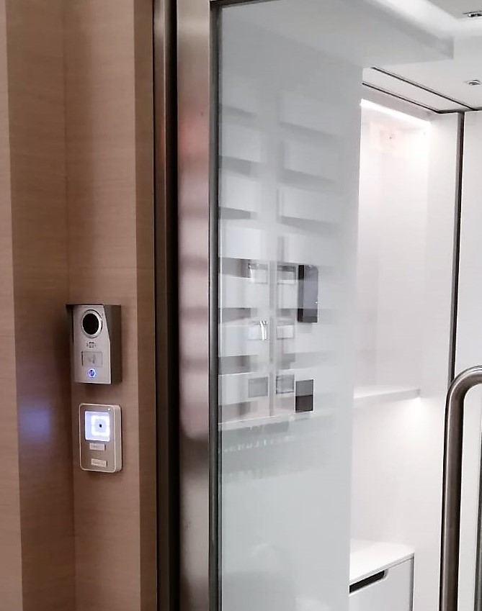
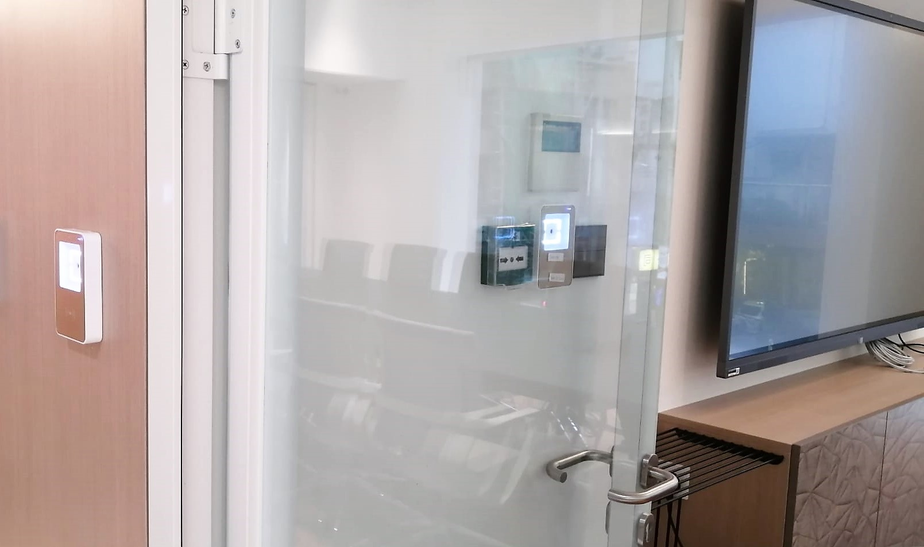
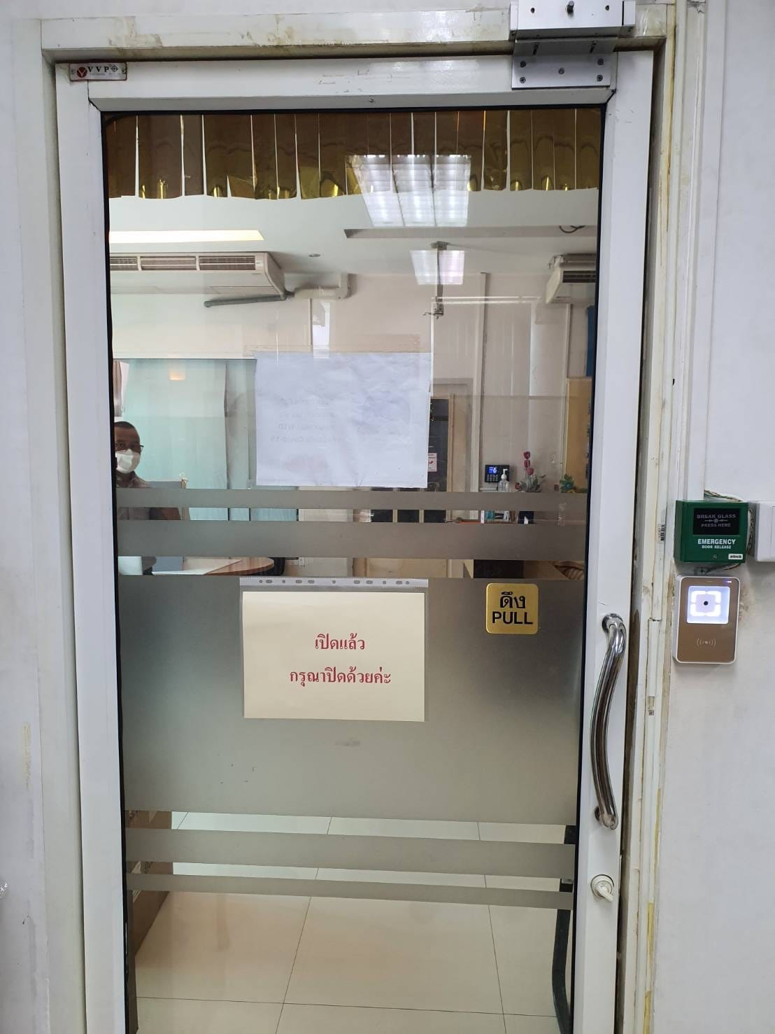
Able to Meet New Considerations in the Digital Connected World
Seamless User Experience & Multi-Tasking Integration
Limited numbers of hardware with a large dynamic group of users
Different groups of taskforce in one system (Need Group Anti-Passback function)
Need to change the access right and schedule frequently
Run access log record / monthly report / target report of a specific person
Digital membership, Visitor Management & e-Ticketing
Personalized Picture Virtual Card on Mobile as future Digital Membership card;
No need to run a separate server on visitor management;
Mobile credential reusable but only work in one mobile phone
Use Mifare card as temporary pass to courier or delivery people
Facilities Booking and Integration with CRM
Manage booking of meeting rooms in co-work space or club house activities
Room time attendance to link with CRM system for calculating of cost and membership benefits
Un-manned facilities booking: Book → Selected Time Range → Pay → Download Mobile Pass → Room

Slide 7
Case Illustration 1 Multi-tasking Access Control System; Better CRM & Member Pass Integration

Slide 8
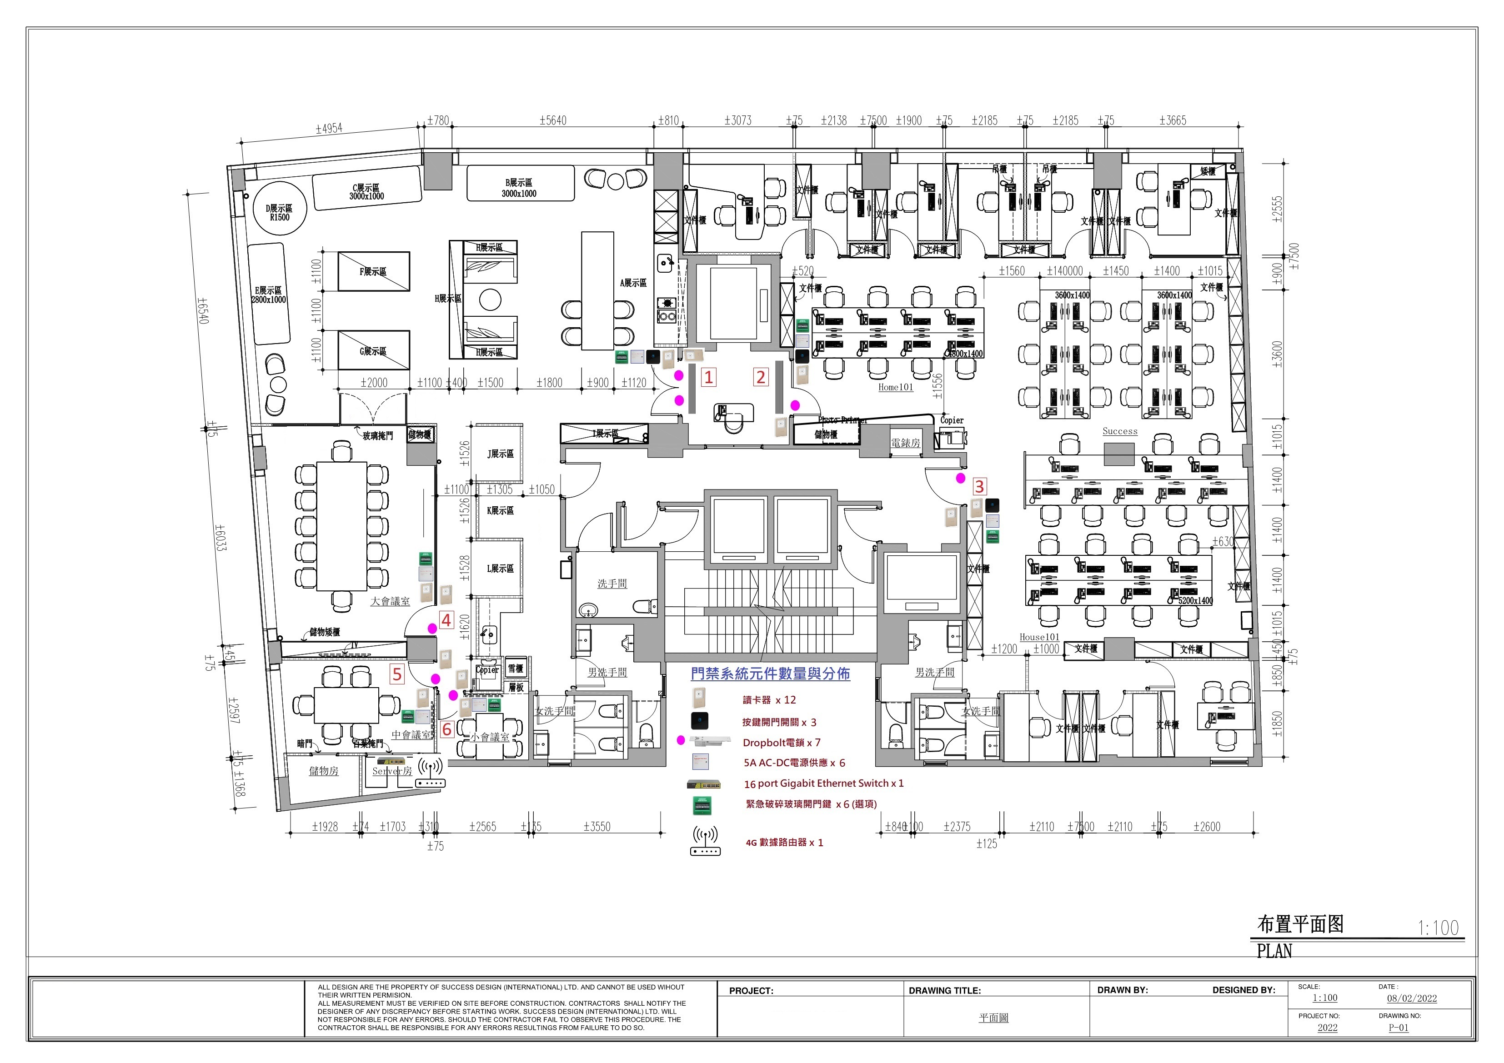
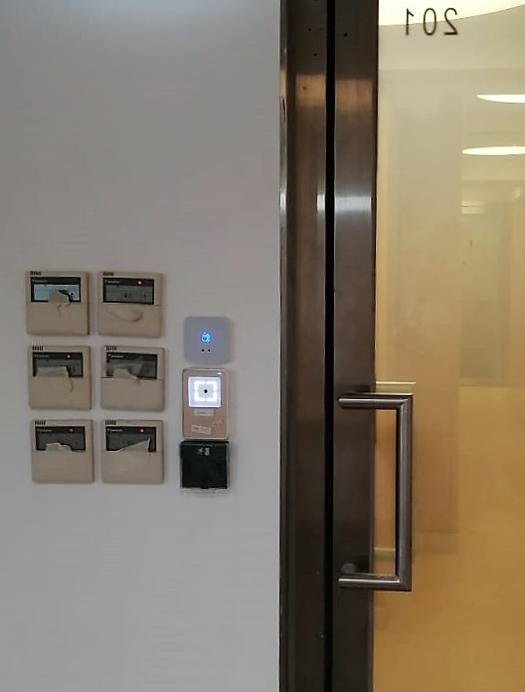
Case: Co-Work Office in Wanchai

Slide 9
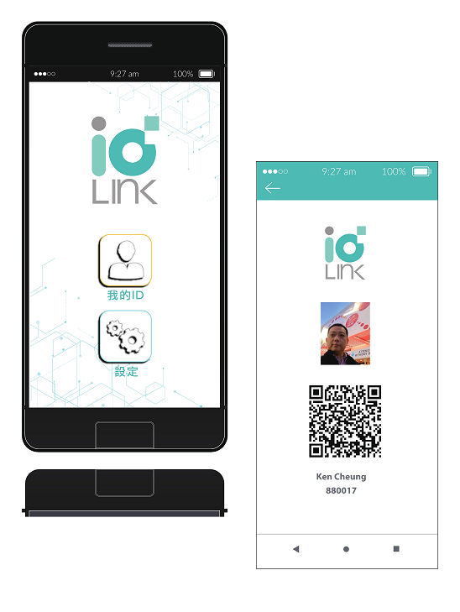
Multi-tasking Requests & Future Integration to CRM
ACS to Serve 3 Different Offices + Meeting Area
Pain-Points: Hybrid use by company staff & endusers (members)
Office space shared by 3 companies of the same group and customers who are members allowed to book 3 meeting rooms in the office.
3 main doors for Time Attendance (TA) and door access records of staff
3 meeting room doors for TA record use by booking members
Need TA record and report down to individual level for easy input to the CRM system of the Group in calculating the excessive usage time of meeting room over entitled member usage.
idLink Cloud ACS Suggestions to Resolve the Situation
One Business Edition Admin. Portal AC to issue Company Pass (virtual in mobile app / Mifare for normal office use) and Member Pass (temporary booking)
Initiate Anti-Passback function for readers at the 3 main doors to deter tailgating
Run constantly TA reports of members for feeding in CRM to calculate necessary fees to be levied to members
Use AC power supply to link Push Button and Break Glass without use of any door controllers
Build a contingency mobile network by establishing a SIM-card-based-Router & UPS between the Group’s IT gateway and the switch linking with all readers. In case the Group’s gateway was down, the SIM router will automatically take up to ensure normal running of the ACS.
Flexibility to use the Personalized Mobile Card as Picture Member Card in future.
API for future integration need to the Group’s digital system.

Slide 10
Case Illustration 2 Cost Effective Digital Migration Simple Architecture with Cloud Network & Save Cost Unlike Before

Slide 11
Cost-Effective ACS Upgrade in Old Residential Estate
Use Mobile Network & Cloud Management w/o Fiber Network
Pain Points: Old facilities without proper security system and resource-draining password management
Old housing estate with 11 blocks of buildings, each of which has 3 doors to manage
The main gate is using standalone keypad panel with intercom system and two other doors on the 2nd floor are using simple locks
PMO couldn’t get any real time security information as there is no optical fiber network to link all blocks
The property management office (PMO) has to spend enormous effort in managing password and sending up-to-date information to residents, changing from time to time
idLink Cloud ACS Suggestions to Resolve the Situation
Use Sim-Based Router to create network instead of establishing the fiber network which is expensive and requires high labour cost in installing
Since idLink ACS needs no controllers to make readers to function, simply build a parallel door access and install the reader next or on top of the existing front door panel by paring out one more relay I/O from the e-lock to the reader.
Provide UPS to enable 24 x 7 operation
Link all necessary Push Button and Break Glass using Access Control Power Supply instead of Door Controllers
Provide a gradual digital migration when PMO is able to issue Mobile Virtual Cards to residents who want to switch from password to mobile usage while keeping the existing practice for who still prefer using passwords can keep using the old panel. Yet, eventually all will migrate to the new system

Slide 12
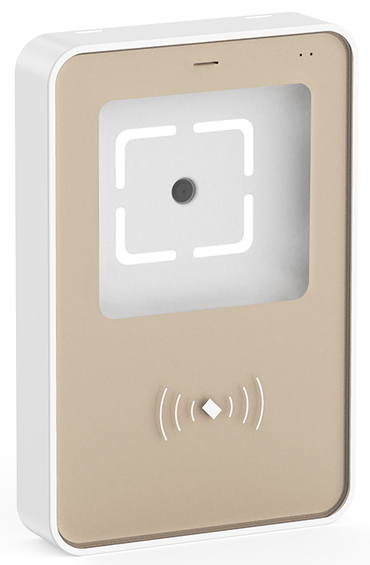
Cost-Effective ACS Upgrade in Old Residential Estate
Use Mobile Network & Cloud Management w/o Fiber Network
Key Benefits
Save the huge cost in optical fiber and related cabling, pipping and installation costs t
Mobile network is basically with zero downtime today
Date SIM cost is also very cheap
Break Glass
Original Keypad & Intercom Panel
UPS
12V SIM Router
G/F
Push Button
12V SIM Router
1/F
X 11 Blocks
UPS
Property Management Office
2/F
UPS
12V SIM Router

Slide 13
Thank You!
謝謝!谢谢!
Terima kasih!
ありがとう!
고맙습니다
Grazie!
Vielen Dank!
Merci!
¡Muchas gracias!
Muito Obrigado
Спасибо!
! شكرا
For details, please contact Kenneth Cheung at kenneth@vrcnltd.com

